Slide 1
Lecture
Machine Learning Basics

Slide 2
Basic concepts
What is Machine Learning?
What is learning?
지도학습(supervised)
비지도학습(unsupervised)
What is 회귀(regression)?
What is 분류(classification)?

Slide 3
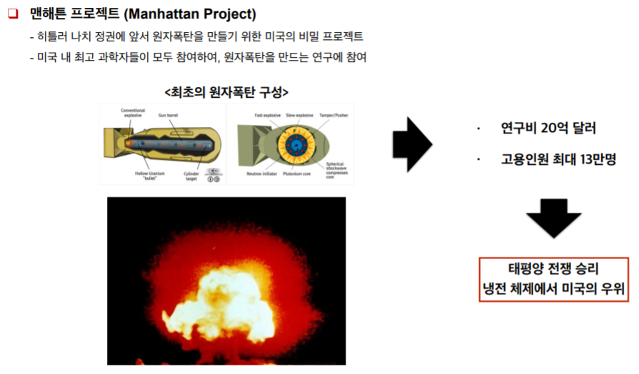

Slide 4
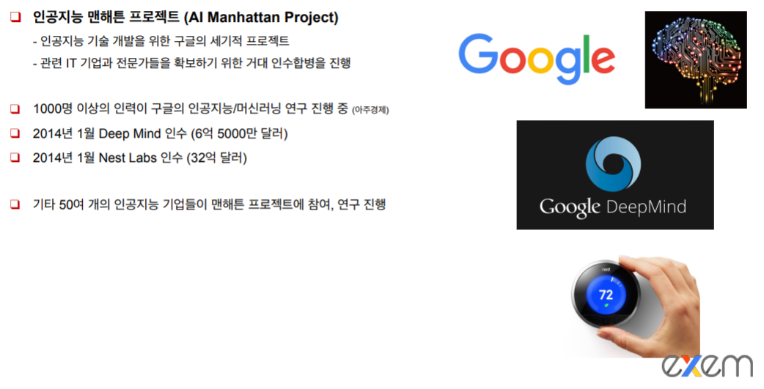

Slide 5
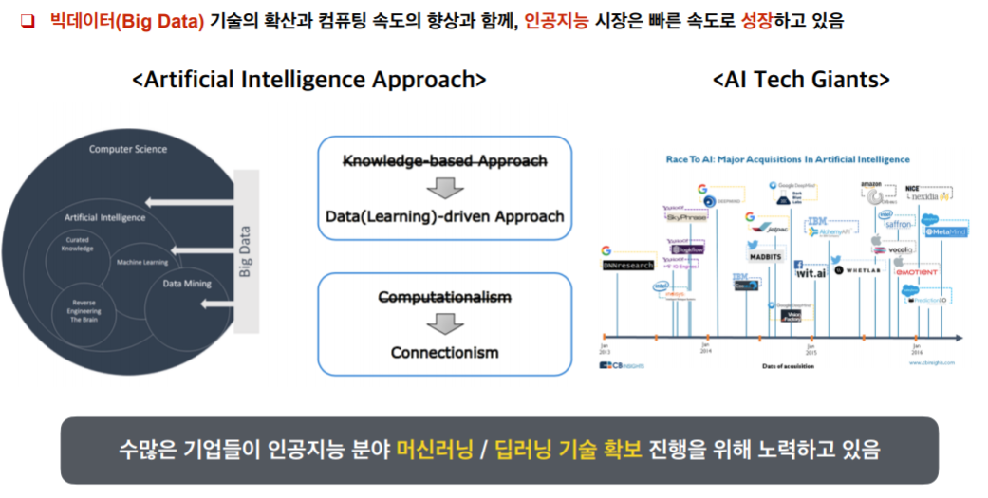

Slide 6
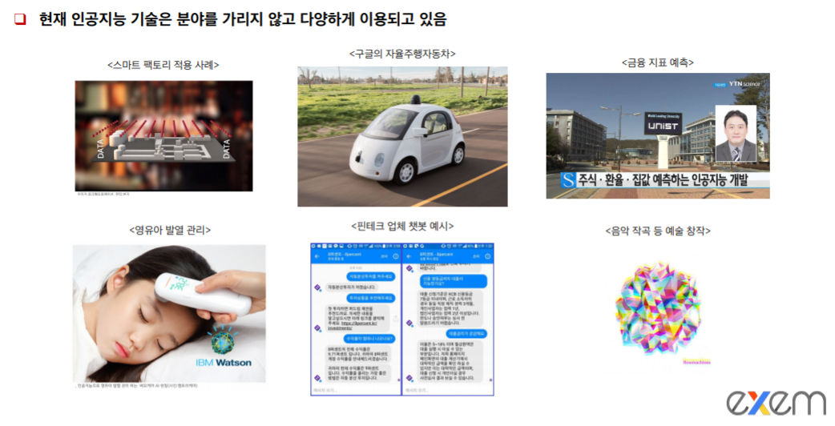
- DeepMind Walking : https://youtu.be/gn4nRCC9TwQ
Fight Scenarios : https://youtu.be/bsUY9wplVYw
Deep Fake : https://youtu.be/vxuG2dPmxUs

Slide 7
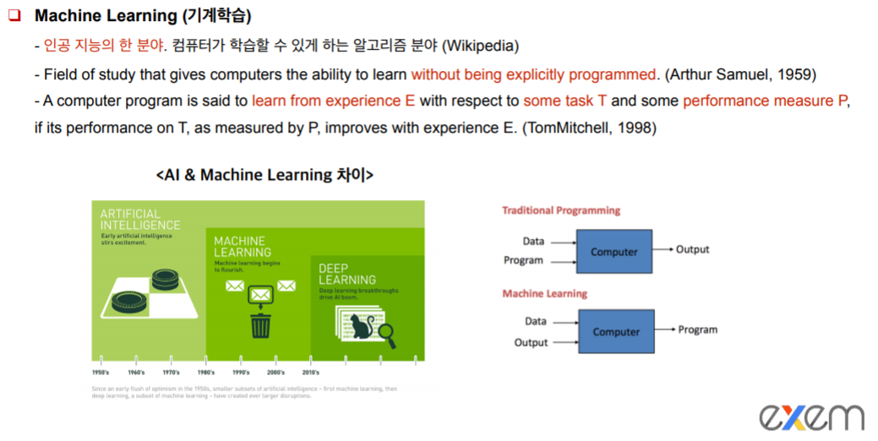

Slide 8
Machine Learning
Limitations of explicit programming(명시적 프로그래밍)
Spam filter: many rules
Automatic driving: too many rules
너무 많은 rules 가 필요함
Machine learning: "Field of study that gives computers the ability to learn without being explicitly programmed” Arthur Samuel (1959)
Input
Computer
Input
Computer
output
logic
logic
output
Explicitly programming
Machine Learning
Notes:
나무 사진을 주고 ＇나무다’
다른 사진을 주고 ‘나무가 아니다＇
라는 걸 학습 시킴

Slide 9
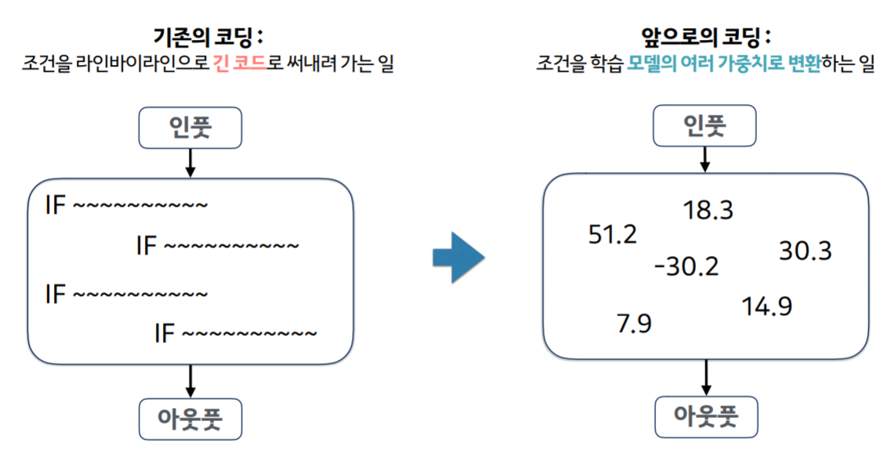
프로그래밍 패러다임의 전환

Slide 10
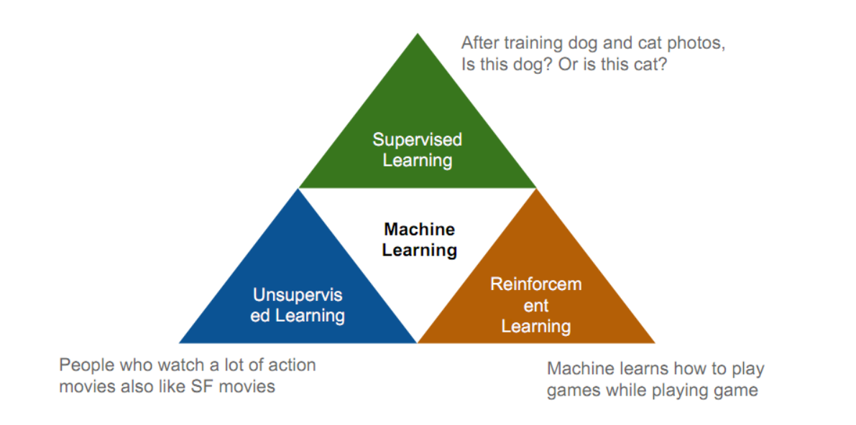

Slide 11
지도학습(Supervised learning):
learning with labeled examples
Target Output 형태에 따라 2가지로 나뉨
Regression : real number or vector
Classification : class label
비지도학습(Unsupervised learning)
정답이 없음 (un-labeled data)
Google news grouping
Word clustering

Slide 12
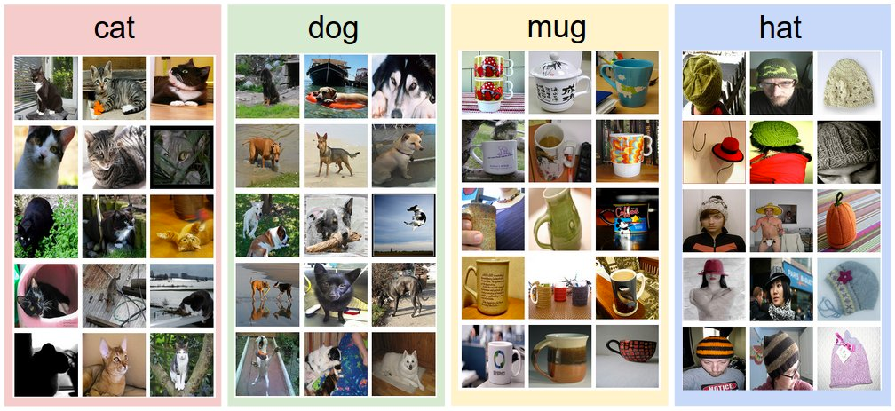
Supervised learning
An example training set for four visual categories.

Slide 13
Supervised learning
Most common problem type in ML
Image labeling: learning from tagged images
Email spam filter: learning from labeled (spam or ham) email
Predicting exam score: learning from previous exam score and time spent

Slide 14
Training data set
ML Model
X | Y
{3,6,9} | 3
{2,5,7} | 2
{2,3,5} | 1
학 습
Training data set
Q. X_test = {3,9,8}
?????

Slide 15
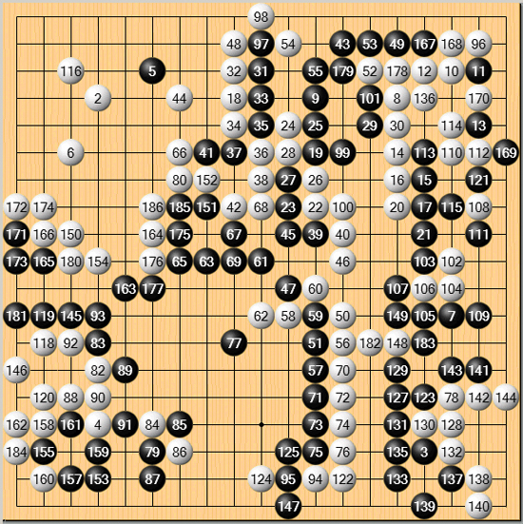
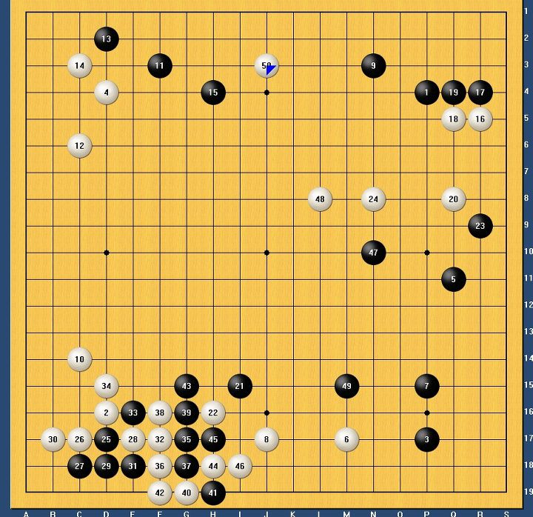
AlphaGo
AlphaGo
학 습
Training data set
?????
Notes:
일종의 supervised learing 이라고 볼 수 있음

Slide 16
Types of supervised learning
Predicting final exam score based on time spent
regression
Pass/non-pass based on time spent
binary classification
Letter grade (A, B, C, E and F) based on time spent
multi-label classification

Slide 17
Predicting final exam score based on time spent
Types of supervised learning
x (hours) | y (score)
10 | 90
9 | 80
3 | 50
2 | 30
x (hours) | y (pass/fail)
10 | P
9 | P
3 | F
2 | F
x (hours) | y (grade)
10 | A
9 | B
3 | D
2 | F
Pass/non-pass based on time spent
Letter grade (A, B, …) based on time spent

Slide 18
Learning Method

Slide 19
